Slide 1

Library Management System
An Integrated Solution for Book Tracking
Built with Java | SQL | JavaFX

Slide 2

System Overview: Empowering Educational Libraries
A comprehensive solution designed to streamline operations for academic institutions, offering robust features for managing all aspects of a library.
Complete Management
Automated Tracking
Seamlessly manage books, students, librarians, and all library transactions.
Effortlessly track book issuance and returns, with integrated automated fine calculations.
Intuitive Interface
A user-friendly, tabbed interface ensures easy navigation and efficient workflow for all users.

Slide 3
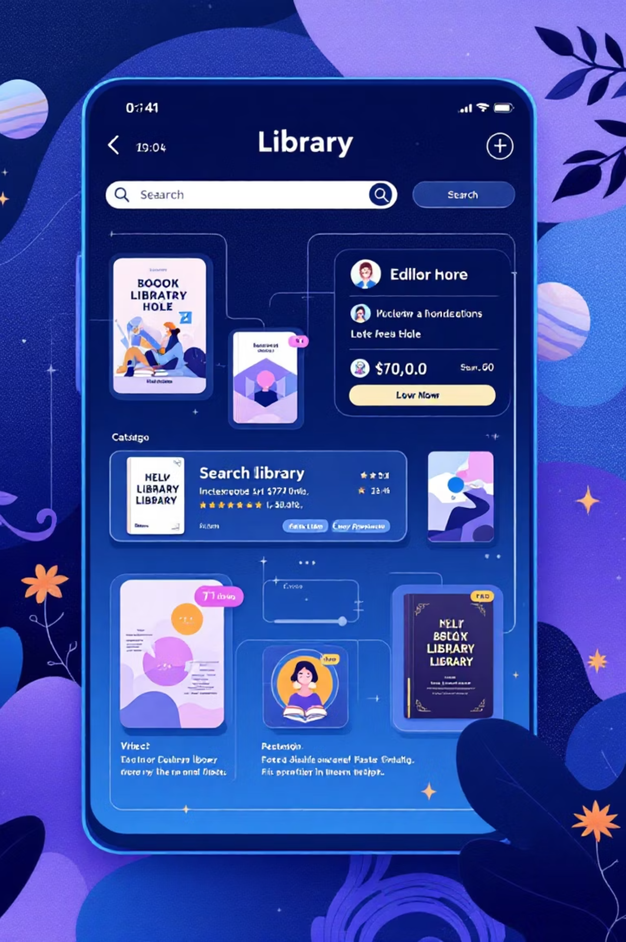




Key Features (Part 1): Core Operations
This system provides essential functionalities to maintain an organized and efficient library environment.
Book Management
Add, update, and delete books, with precise quantity tracking to maintain accurate inventory.
Student Management
Register new students and efficiently manage their personal details and borrowing history.
Librarian Authentication
Ensures secure access and operations through a dedicated login for library staff.
Issue/Return Tracking
Real-time monitoring of all book transactions, ensuring accountability and preventing losses.

Slide 4

System Architecture: Layers of Functionality
The system follows a clear architectural design, separating concerns for maintainability and scalability.
Model Layer
View Layer
Book.java: Defines book attributes and behaviors.
BookView.java: User interface for book management.
Student.java: Manages student information and interactions.
StudentView.java: Interface for student record handling.
Librarian.java: Handles librarian data and authentication.
LibrarianView.java: Login and administrative screens.
IssueReturn.java: Tracks borrowing and return specifics.
IssueReturnView.java: UI for transaction processing.

Slide 5

Java: The Core Logic Engine
Leveraging Java's robust capabilities, the system's backend is built for efficiency and reliability.
Object-Oriented Design
Business Logic
Uses classes for Book, Student, Librarian, and IssueReturn entities, ensuring modular and reusable code.
Fine calculation is precisely implemented using Java's LocalDate and ChronoUnit for accurate time-based penalties.
Main Application
Collections Framework
LibraryMain.java serves as the central entry point, coordinating all system operations and user interactions.
ArrayLists are utilized for efficient in-memory data management, optimizing performance for frequently accessed data.

Slide 6
SQL: Database Schema Foundation
Four meticulously designed tables form the backbone of the system, ensuring data integrity and efficient retrieval.
Book
bookId
title, publisher, quantity
Student
studentId
name, branch
Librarian
librarianId
name, password
IssueReturn
Composite
studentId, bookId, issueDate, returnDate
Each table is structured to store specific information, interlinked to support all library operations.

Slide 7








Database Integration: Seamless Connectivity
Reliable and secure database interaction is achieved through careful implementation of JDBC.
DBHelper.java
MySQL Database
Manages all database connections centrally using JDBC, simplifying resource management.
Connects to 'library_db' hosted locally at localhost:3306 for data persistence.
Transaction Management
Prepared Statements
Includes auto-commit control to maintain data consistency and integrity across operations.
Ensures robust security by preventing SQL injection through parameterized queries.

Slide 8

Thank You!
We appreciate your time and interest in our Library Management System.
Our system is designed to revolutionize library operations, making management efficient, intuitive, and highly reliable.

